Slide 1


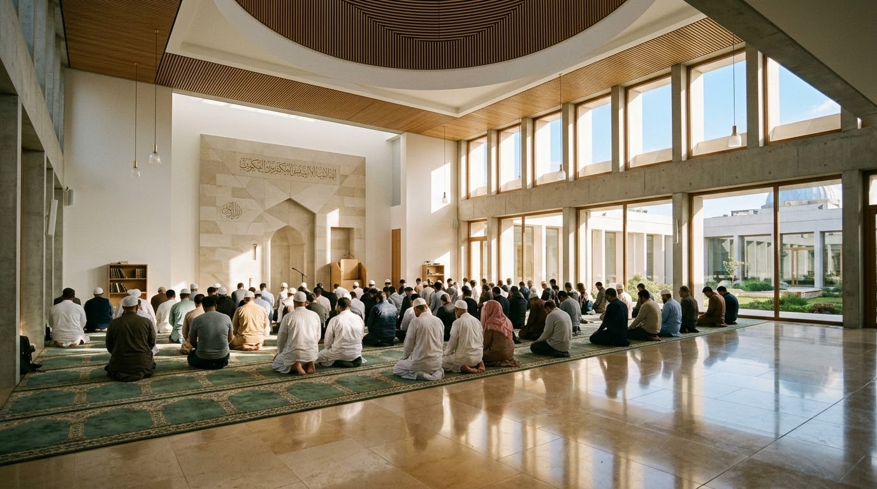
AL-SUFFAH
Welcome to Al-Suffah Institute & Mosque
Nurturing Faith, Knowledge, and Community

Slide 2
Overview & History
Founding Principles and Vision
AL-SUFFAH
Sacred Inspiration
Al-Suffah Institute & Mosque was established to serve as a beacon of traditional Islamic learning and a central hub for community spiritual growth.
The name 'Al-Suffah' draws direct inspiration from the original 'Ashab al-Suffah' (The People of the Bench) in the Prophet Muhammad's mosque in Medina, who dedicated their lives entirely to the pursuit of sacred knowledge and spiritual purification.
Evolution & Vision
Our institute was founded on the vision of replicating this profound dedication to learning within the modern era, providing a sanctuary where faith and intellect can flourish simultaneously.
From our humble beginnings as a small community prayer space, we have steadily grown into a comprehensive educational and spiritual center. This evolution reflects the deep-rooted commitment of our founding members to establish an institution that not only preserves classical Islamic scholarship but also makes it highly accessible and deeply relevant to contemporary daily life. We remain steadfast in our commitment to fostering a vibrant, educated, and spiritually grounded community.

Slide 3
Mission & Values
Serving the Community through Faith and Knowledge
Our core mission integrates profound spiritual development with comprehensive community service and academic excellence. At Al-Suffah, we believe that true Islamic education must translate into positive societal impact.
By bridging classical Islamic scholarship with an understanding of contemporary societal needs, we aim to nurture a balanced identity that allows our congregants to thrive spiritually and civically.
01
Spiritual Excellence (Ihsan)
Cultivating a deep, conscious relationship with Allah through sincere worship and continuous self-purification.
02
Academic Rigor
Upholding the highest standards in teaching classical Islamic sciences, ensuring authenticity and depth in all our educational offerings.
03
Community Service (Khidmah)
Recognizing that serving humanity is an integral part of faith, driving our commitment to charitable initiatives and social support.
04
Inclusivity and Brotherhood
Fostering a welcoming environment that embraces the rich diversity of the Muslim Ummah, promoting unity, mutual respect, and strong communal bonds.
AL-SUFFAH

Slide 4
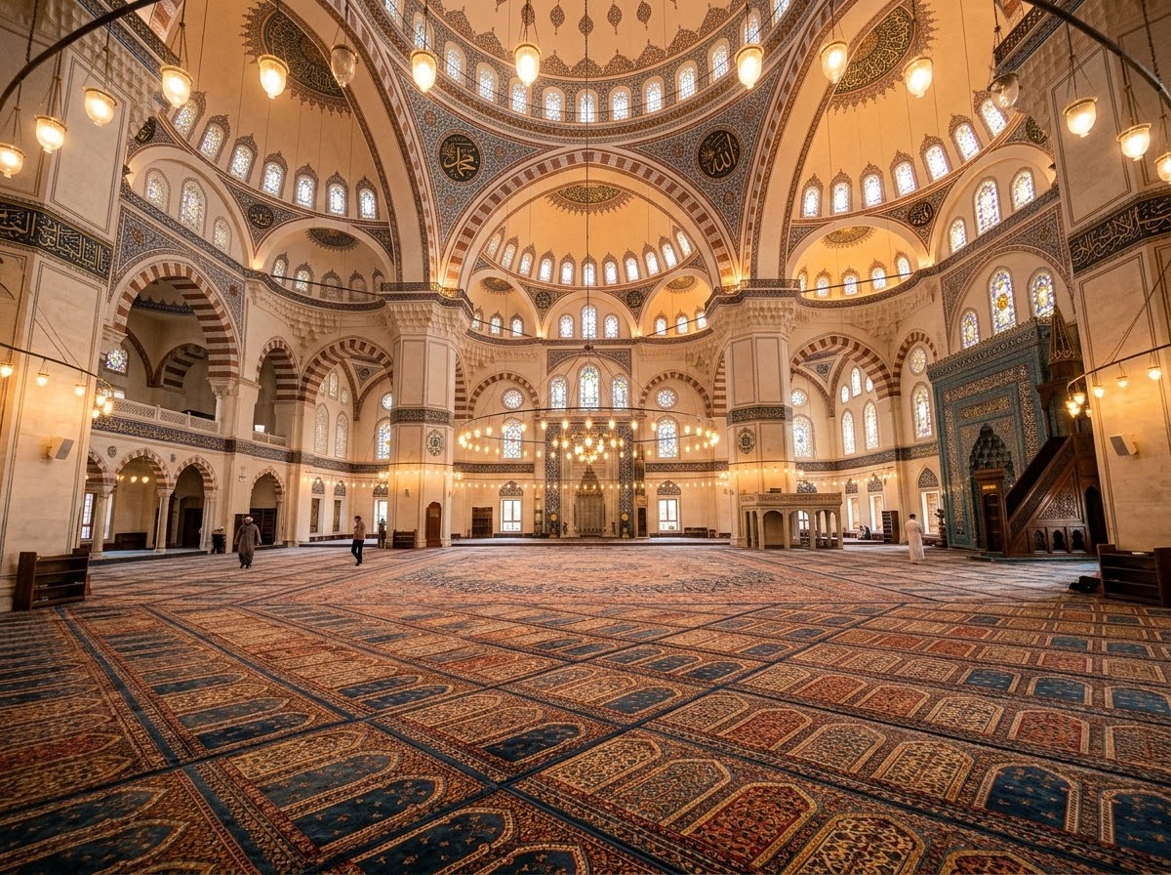
Mosque Services
Daily Prayers, Friday Khutbah, & Spiritual Guidance
AL-SUFFAH
The mosque serves as the spiritual heartbeat of our community, offering daily and weekly congregational services designed to keep hearts connected to the Divine.
Daily & Friday Prayers (Salah)
We facilitate the five daily prayers in congregation in a peaceful, uplifting environment. Weekly Jumu'ah prayers feature inspiring Khutbahs by qualified scholars, with multiple shifts to accommodate our growing community.
Ramadan Worship
During Ramadan, the mosque becomes a vibrant center of worship hosting daily Iftar gatherings and nightly Tarawih prayers led by expert Quran reciters.
Spiritual Guidance & Counseling
Our Imam and resident scholars provide family dispute resolution (Sulh), pre-marital counseling, and personal spiritual advice to support individuals and families.
Continuous Learning
Regular, brief Tafsir (exegesis) and Hadith circles follow daily prayers for ongoing spiritual nourishment.

Slide 5
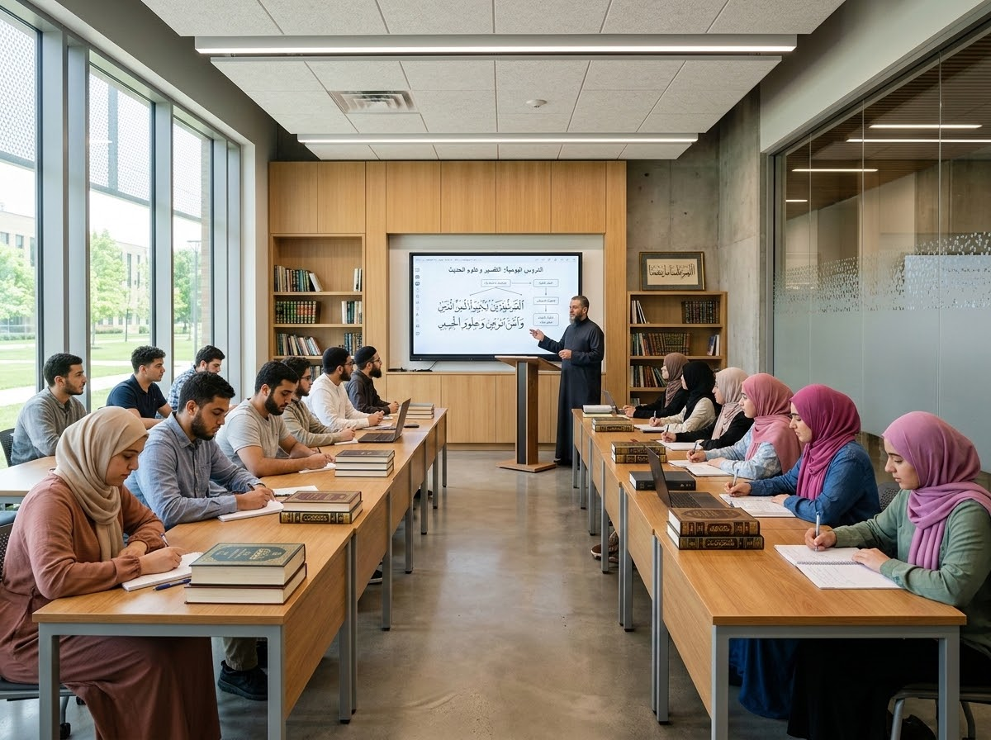

Educational Programs
Quranic Studies & Classical Islamic Sciences
AL-SUFFAH
Our academic curriculum provides structured, rigorous pathways in both Quranic memorization and classical Islamic sciences, designed to produce knowledgeable and articulate ambassadors of the faith.
Hifz Program
A dedicated track for students to meticulously memorize the Holy Quran with proper Tajweed (rules of recitation), guided by certified instructors with traditional Ijazah (chains of transmission).
Alim / Alimah Course
A comprehensive multi-year curriculum covering essential Islamic sciences, including Fiqh (jurisprudence), Aqeedah (theology), Seerah (prophetic biography), and Usul al-Hadith (principles of prophetic traditions).
Holistic Student Growth
Our pedagogical approach ensures students not only memorize foundational texts, but profoundly understand their application in today's modern world.
Traditional Transmission & Modern Pedagogy
Combining time-honored transmission with modern classroom methodologies. Regular assessments and academic counseling ensure each student reaches their highest potential.

Slide 6

Youth & Adult Education
Weekend School and Continuing Learning
AL-SUFFAH
Youth Programs
Adult Continuing Learning
Maktab (Weekend School)
Provides children and teenagers with a strong foundation in Islamic studies, Arabic reading, and essential character building (Tarbiyah) in a fun, engaging environment.
Youth Mentorship & Engagement
Recognizing modern challenges, we host dedicated mentorship programs, interactive summer retreats, and leadership training seminars to keep the younger generation confidently engaged with their faith.
Flexible Class Schedules
We offer a robust schedule of evening and weekend classes tailored specifically for lifelong learning opportunities for adults at every stage of life.
Core Curriculum & Social Ethics
Programs focus on practical, everyday Fiqh, conversational Arabic, and seminars addressing contemporary social and ethical issues from an Islamic perspective.
Multi-Generational Impact: Guarantees that the entire family can grow together in knowledge and practice.

Slide 7

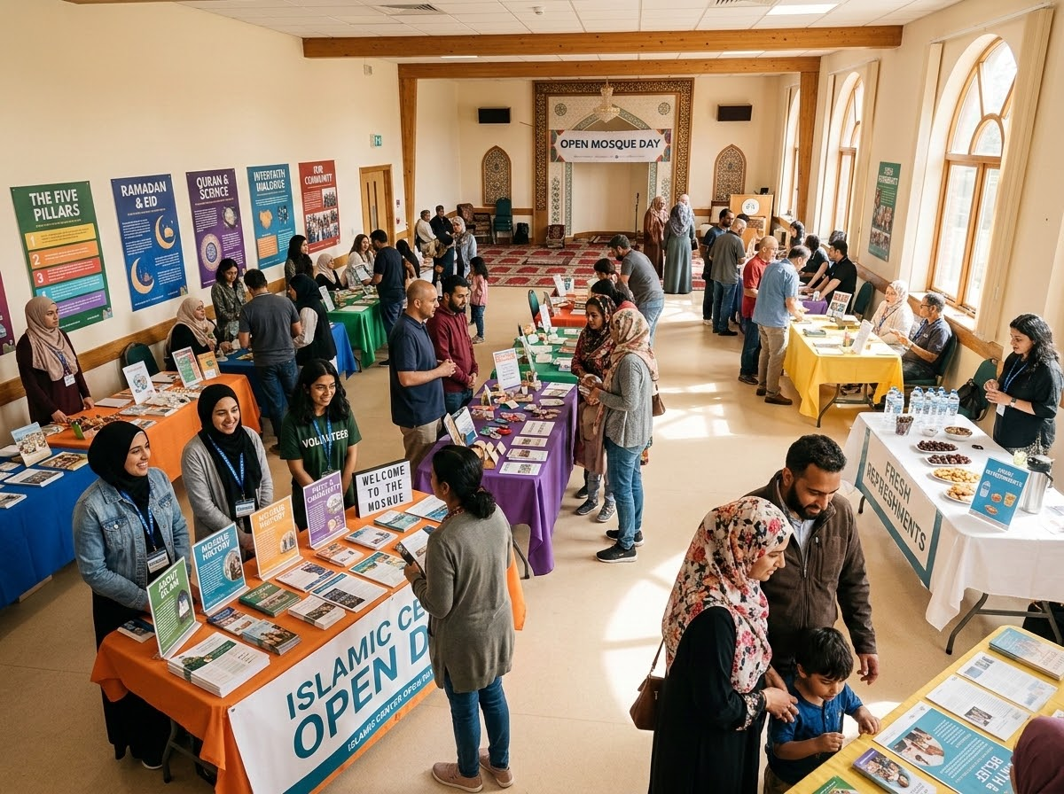
Community Outreach
Inter-Faith Dialogue & Neighborhood Initiatives
AL-SUFFAH
Open Mosque Days
Inviting neighbors, local officials, and the general public to tour facilities, observe prayers, and ask questions in a welcoming environment.
Inter-Faith Dialogue
Participating with local churches, synagogues, and civic organizations to build bridges of understanding, demystify Islam, and combat misconceptions.
Active Civic Engagement
Mobilizing for neighborhood cleanups, blood donation camps, and environmental sustainability initiatives to demonstrate neighborliness and public service.

Slide 8
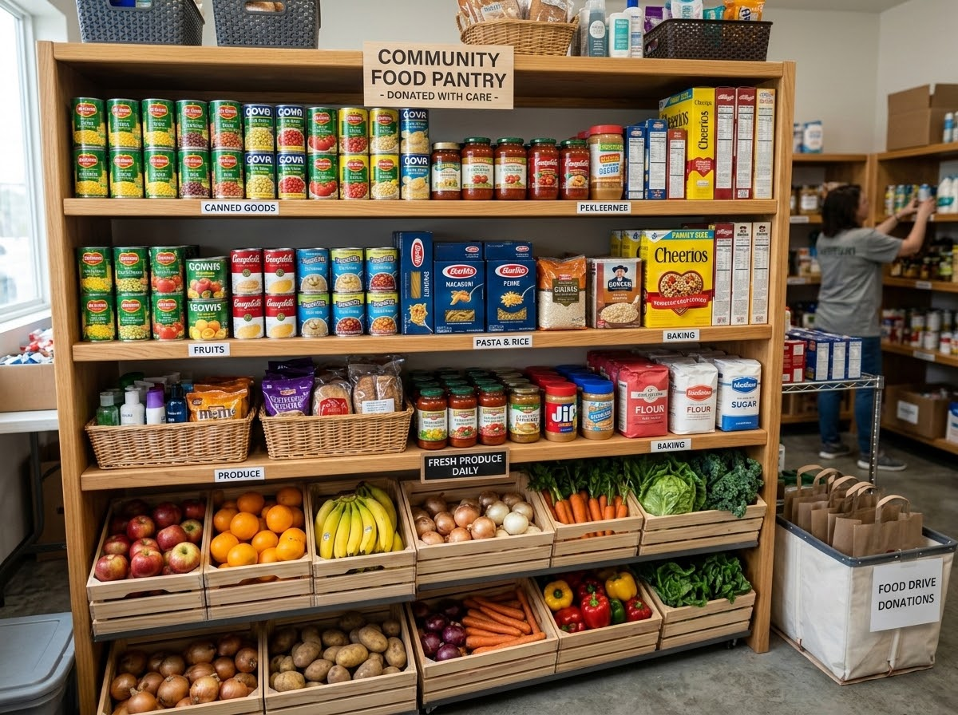
Social Services
Charitable Aid, Food Drives, and Support Programs
AL-SUFFAH
Driven by the profound Islamic mandates of Zakat (obligatory charity) and Sadaqah (voluntary charity), our social services department provides critical, life-sustaining support to vulnerable populations within and beyond our congregation.
Community Food Pantry: Al-Suffah operates a community food pantry that distributes essential groceries to families facing food insecurity, regardless of their background or faith.
Zakat Management & Direct Aid: We meticulously manage the collection and distribution of Zakat, ensuring funds are channeled directly to local families in severe financial distress, assisting with rent, utilities, and emergency medical expenses.
Refugee Resettlement: We actively support refugee resettlement programs, providing newly arrived families with household goods, language translation assistance, and community integration support.
Healthcare & Wellness Initiatives: Through strategic partnerships with local NGOs and Muslim healthcare professionals, we also host periodic free medical clinics, wellness checks, and mental health awareness workshops, fulfilling our duty to care for the holistic well-being of the community.

Slide 9
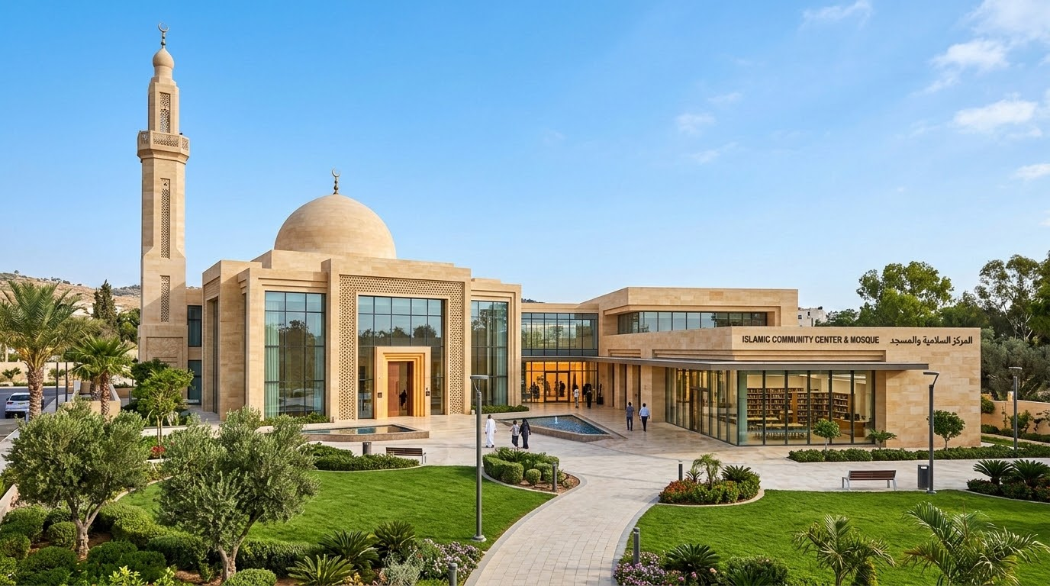
Facilities & Infrastructure
Prayer Halls, Classrooms, and Community Spaces
AL-SUFFAH
Main Musalla
The architectural centerpiece features dedicated, spacious, and equally beautiful accommodations for both men and women, ensuring a serene environment for contemplation and worship.
Classrooms & Library
Equipped with state-of-the-art digital learning tools supporting modern pedagogy. A specialized Islamic library provides access to classical texts and contemporary literature.
Our purpose-built facility is thoughtfully designed to accommodate the growing spiritual, educational, and social needs of our dynamic congregation.
Banquet Hall
A versatile community infrastructure utilized for hosting community dinners, weddings (Nikah ceremonies), and large educational seminars to foster strong social bonding.
Youth Lounge & Gym
Incorporates a dedicated youth lounge and gymnasium space, offering younger community members a safe, halal environment for healthy recreation and socialization.

Slide 10
Fundraising & Financial Sustainability
Supporting Our Operations & Community Growth
AL-SUFFAH
Operational Needs: Daily operations, facility maintenance, utilities, and fair compensation for dedicated Imams, teachers, and staff rely entirely on the generous, sustained financial support of our congregation.
01
Recurring Donors
Core Operations
Our most critical initiative. Provides the predictable monthly revenue stream necessary to maintain daily operations and ongoing institute stability.
02
Ramadan Drive
Capital Projects
An annual major fundraising drive dedicated to funding expansive capital projects, facility improvements, and major infrastructure upgrades.
03
Waqf Endowment
Self-Sustaining
Actively developing an endowment by investing in commercial properties to generate long-term, self-sustaining revenue for the mosque.
04
Transparency
Sadaqah Jariyah
Strict financial accountability with regular reports. Supporting the house of Allah offers continuous charity with eternal rewards.

Slide 11
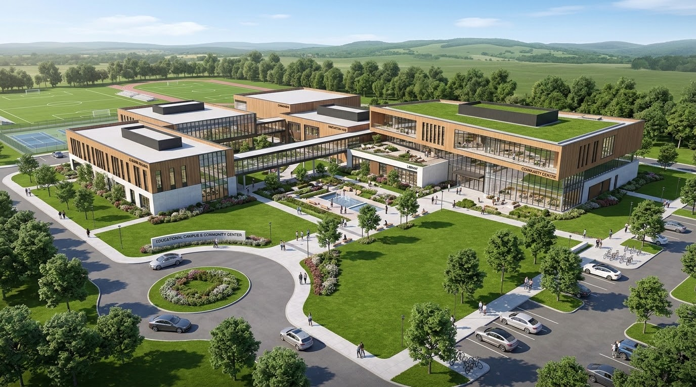
Future Vision & Expansion Projects
Building for Future Generations
AL-SUFFAH
As our community experiences rapid demographic growth, Phase 2 expansion strategically plans physical and programmatic projects to adequately serve the next generation of Muslims.
Full-Time K-12 Islamic School
Establishment of an accredited school providing a seamless integration of state-standard academics and Islamic theology.
Land & Facility Expansion
Acquiring adjacent land for expanded parking and constructing a dedicated, multi-purpose community center with advanced athletic facilities.
Commercial Endowment Property
Securing a permanent financial engine to subsidize mosque operations, ensuring long-term sustainability for decades to come.
PHASE 2 EXPANSION PROJECT
A transformative vision designed to significantly increase capacity, foster community leadership, and secure Al-Suffah's institutional foundation.

Slide 12
AL-SUFFAH
Conclusion & How to Get Involved
Al-Suffah Institute & Mosque is your community, and its success depends on your active participation. We invite every individual to become an active pillar of this institution by contributing your time, professional skills, and financial resources.
There are three primary ways to get involved today:
1
Donate
2
Volunteer
3
Connect
Set up a recurring monthly donation via our secure online portal to support our daily operations and future expansion.
Join one of our many committees. We are currently seeking volunteers for the weekend school, the social services food drive, and the facility maintenance team.
Subscribe to our weekly newsletter, follow our official social media channels, and join our community broadcast groups to stay informed about upcoming classes and events.
"We conclude with a sincere Dua (prayer) that Allah blesses our community, accepts our efforts, and keeps our hearts united in faith and service."

